Slide 1
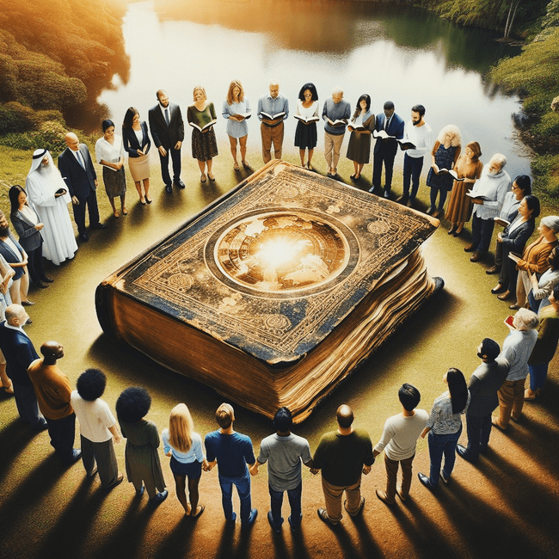
THE CHURCH
Matthew 16:15-18
Notes:
Will Gossett ~ May 5, 2024 (Eloy AM)

Slide 2
Matthew 16:15-18 (NASB)
¹⁵ He said to them, "But who do you say that I am?" ¹⁶ Simon Peter answered, "You are the Christ, the Son of the living God."

Slide 3
Matthew 16:15-18 (NASB)
¹⁷ And Jesus said to him, "Blessed are you, Simon Barjona, because flesh and blood did not reveal this to you, but My Father who is in heaven.

Slide 4
Matthew 16:15-18 (NASB)
¹⁸ "I also say to you that you are Peter, and upon this rock I will build My church; and the gates of Hades will not overpower it.

Slide 5
There are over 38,000 “churches” in the world today. Now we know that the New Testament was established 2024 years ago. Simple math tells us that this is an average of 18.7 “churches” being established each year.

Slide 6
The weird part of this is not all of these “churches” are teaching the same thing, nor or they worshipping the same way. In fact, some will say it’s OK to do this or that, while others will say it’s forbidden to do this or that, yet all these folks believe that they’re saved…

Slide 7
I Corinthians 14:33 (NKJV)
For God is not the author of confusion but of peace, as in all the churches of the saints.

Slide 8
The Church
Three Points
The Church
Man’s Interference
Attaining Membership

Slide 9
The Church
Acts 2:46-47 (KJV)
Ephesians 1:22-23 (NAS)
Ephesians 5:25-27 (NAS)

Slide 10
Acts 2:46-47 (KJV)
⁴⁶ And they, continuing daily with one accord in the temple, and breaking bread from house to house, did eat their meat with gladness and singleness of heart,

Slide 11
Acts 2:46-47 (KJV)
⁴⁷ Praising God, and having favour with all the people. And the Lord added to the church daily such as should be saved.

Slide 12
Ephesians 1:22-23 (NASB)
²² And He put all things in subjection under His feet, and gave Him as head over all things to the church,
²³ which is His body, the fullness of Him who fills all in all.

Slide 13
Ephesians 5:25-27 (NASB)
²⁵ Husbands, love your wives, just as Christ also loved the church and gave Himself up for her,
²⁶ so that He might sanctify her, having cleansed her by the washing of water with the word,

Slide 14
Ephesians 5:25-27 (NASB)
²⁷ that He might present to Himself the church in all her glory, having no spot or wrinkle or any such thing; but that she would be holy and blameless.

Slide 15
Point #2: Man’s Interference
Acts 20:28-30 (KJV)
II Timothy 3:1-7 (NASB)
Galatians 1:6-9 (NASB)
II Peter 2:1-2 (NASB)
II Timothy 4:1-4 (NKJV)

Slide 16
Acts 20:28-30 (KJV)
²⁸ Take heed therefore unto yourselves, and to all the flock, over the which the Holy Ghost hath made you overseers, to feed the church of God, which he hath purchased with his own blood.

Slide 17
Acts 20:28-30 (KJV)
²⁹ For I know this, that after my departing shall grievous wolves enter in among you, not sparing the flock.
³⁰ Also of your own selves shall men arise, speaking perverse things, to draw away disciples after them.

Slide 18
II Timothy 3:1-7 (NASB)
¹ But realize this, that in the last days difficult times will come. ² For men will be lovers of self, lovers of money, boastful, arrogant, relivers, disobedient to parents, ungrateful, unholy,

Slide 19
II Timothy 3:1-7 (NASB)
³ unloving, irreconcilable, malicious gossips, without self-control, brutal, haters of good, ⁴ treacherous, reckless, conceited, lovers of pleasure rather than lovers of God,

Slide 20
II Timothy 3:1-7 (NASB)
⁵ holding to a form of godliness, although they have denied its power; Avoid such men as these. ⁶ For among them are those who enter into households and captivate weak women weighed down with sins, led on by various impulses,

Slide 21
II Timothy 3:1-7 (NASB)
⁷ always learning and never able to come to the knowledge of the truth.

Slide 22
Galatians 1:6-9 (NASB)
⁶ I am amazed that you are so quickly deserting Him who called you by the grace of Christ, for a different gospel; ⁷ which is really not another;

Slide 23
Galatians 1:6-9 (NASB)
only there are some who are disturbing you and want to distort the gospel of Christ.

Slide 24
Galatians 1:6-9 (NASB)
⁸ But even if we, or an angel from heaven, should preach to you a gospel contrary to what we have preached to you, he is to be accursed!

Slide 25
Galatians 1:6-9 (NASB)
⁹ As we have said before, so I say again now, if any man is preaching to you a gospel contrary to what you received, he is to be accursed!

Slide 26
II Peter 2:1-2 (NASB)
¹ But false prophets also arose among the people, just as there will also be false teachers among you, who will secretly introduce destructive heresies, even denying the Master who bought them, bringing swift destruction upon themselves.

Slide 27
II Peter 2:1-2 (NASB)
² Many will follow their sensuality, and because of them the way of the truth will be maligned;

Slide 28
II Timothy 4:1-4 (NKJV)
¹ I charge you therefore before God and the Lord Jesus Christ, who will judge the living and the dead at His appearing and His kingdom:
² Preach the word! Be ready in season and out of season.

Slide 29
II Timothy 4:1-4 (NKJV)
Convince, rebuke, exhort, with all longsuffering and teaching. ³ For the time will come when they will not endure sound doctrine, but according to their own desires, because they have itching ears, they will heap up for themselves teachers;

Slide 30
II Timothy 4:1-4 (NKJV)
⁴ and they will turn their ears away from the truth, and be turned aside to fables.

Slide 31
People are going to justify their actions. Most of these folks will talk about their denomination. If we say the word denomination here in this setting, everyone here is going to think about other “churches”,

Slide 32
yet if we’re standing in line at the bank and we use the word denomination, we’ll think of something entirely different, right? The word denomination means to name and to divide, such as 1’s, 5’s, 20’s…..

Slide 33
these bills are different, just like the other denominations. With that in mind, the Latin word Catholic is translated Universal, so by definition, after the council of Nicea in AD 325, the “Universal Roman church” was established by men…

Slide 34
Point #3: Attaining Membership in Christ’s Church
Romans 10:17 (KJV)
Hebrews 11:6 (KJV)
Luke 13:3 (KJV)
Matthew 10:32-33 (KJV)
Acts 22:16 (KJV)
Matthew 28:19-20 (KJV)

Slide 35
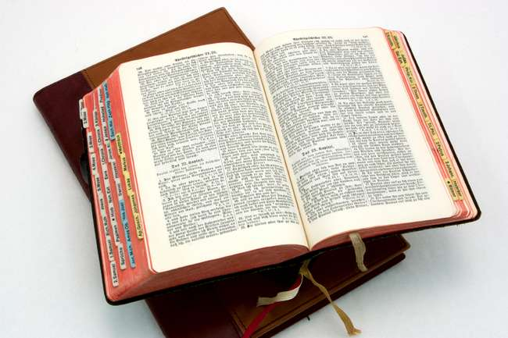
Hear: Romans 10:17
So then faith cometh by hearing, and hearing by the word of God.

Slide 36
Believe: Hebrews 11:6
But without faith it is impossible to please him: for he that cometh to God must believe that he is, and that he is a rewarder of them that diligently seek him.

Slide 37
Repent: Luke 13:3
I tell you, Nay: but, except ye repent, ye shall all likewise perish.

Slide 38
Confess: Matthew 10:32-33
32 Whosoever therefore shall confess me before men, him will I confess also before my Father which is in heaven.
33 But whosoever shall deny me before men, him will I also deny before my Father which is in heaven.

Slide 39
Baptize: Acts 22:16
And now why tarriest thou? arise, and be baptized, and wash away thy sins, calling on the name of the Lord.

Slide 40

…that Christ died for our sins according to the scriptures;
And that he was buried, and that he rose again the third day according to the scriptures:

